Slide 1
AR Shopping Application
Minions
Sahil Shah 1505247
Bhuvan Khanna 1512544
Reena Kumari Lohana 1498290
Resmi Kizhakkekuttu Jose 1492400
Meichen Zhou 1505251

Slide 2
Vision
For the customers ,
Who want to buy apparel, shoes and accessories online.
The "Augmented Reality AR Application "
Is a mobile application
That will help the customers to try products using Ar technology which helps you to decide what looks best on you and also allows to take screenshots and share online.
Unlike other shopping application which provides product catalogue this app will save a lot of time by avoiding trial rooms.

Slide 3
Product backlock sprint 0
In sprint 0 the value added at the time of delivery was that we were able to provide a usual online shopping experience.

Slide 4
Product backlog sprint 1
As shopper, I want to select gender option, so that I can try the categories according to my gender.
As Shopper, I want to enter my body details, so that my body size can be recorded by the system.
As a shopper, I want to edit my body size details, so that I can update my details of the selected product
As a shopper, I want to select the skin tone from the options, so that I can choose my skin tone.

Slide 5
Sprint 1
As a shopper, I want to see how the clothes suits on my body , so that I can add to the cart.
As a shopper, I want to swipe the color options, so that I can try different colors of the same clothes.
As a shopper, I want to be able to take a screenshot ,so that I can save and share the picture.
As a shopper, I want to be able to change the background ,so that I can get the perfect look according to occasion.

Slide 6
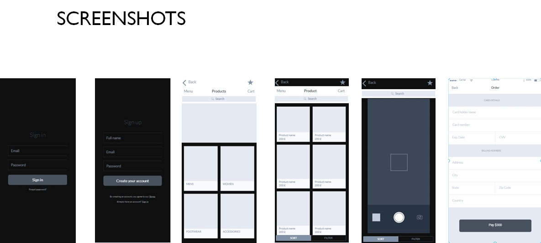
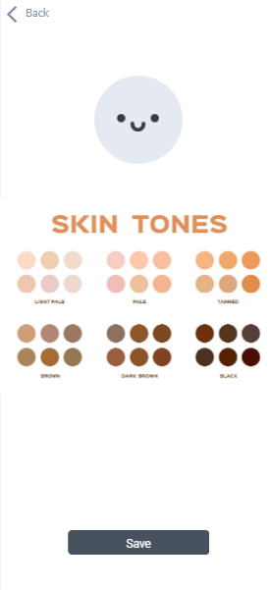
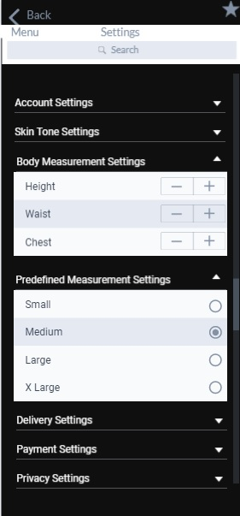
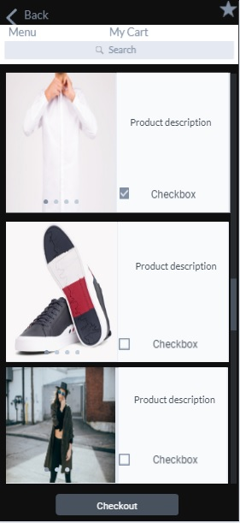

Slide 7
Burn down chart

Slide 8
Retrospective
Went well
Team participation has improved(Team Collaborative)
We tested based on acceptance criteria on each user story before the coding to ensure the product quality.(TDD)
Knowledge regarding the agile practices has been increased(Focus on Product)
Each team member has developed one or the other skills while consideration during sprint 0 which contribute the velocity in sprint 1(Focus on Quality)
The Team choose Git as our Source control tool.(Performance Continuous Integration )
Team setup the continuous integration server with automation tool like Jenkins and create the automated delivery pipeline.(Continuous integration)
Also, the automation testing technique such as Appium is introduced to improve efficiency. Didn’t went well
Team has an extra pressure to finish the task on time as more time went on exploring, understanding and learning new technologies

Slide 9
Thank you

